Slide 1
Big Mountain Ski Resort, Montana Case Study for Business Strategy
Aditya Salunkhe

Slide 2
Market overview
The Ski and Snowboard Resorts industry is expected to continue growing at a higher rate over the few years
As per capita disposable income continues to increase, many Americans will likely continue spending on vacations and activities, such as skiing and snowboarding
IBISWorld anticipates industry revenue to increase at an annualized rate of 3.6% to $3.4 billion over the next five years

Slide 3
Business Objective
Big Mountain Ski Resort suspects it may not be maximizing its returns, as far its market position is concerned
It also does not have a strong sense of facilities that are valuable to its visitors
This data science project aims to build a predictive model for ticket price based on a number of facilities, or properties, boasted by resorts (at the resorts)

Slide 4
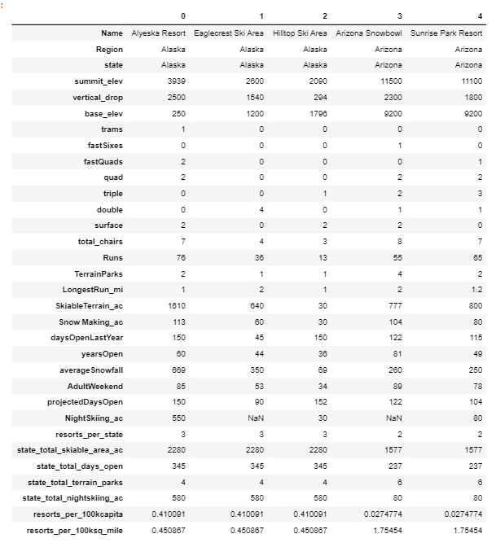
Feature Engineering
Target column was identified as 'AdultWeekday', i.e. 'Price’
Features were prepared as per four columns: TerrainParks, SkiableTerrain_ac, daysOpenLastYear and NightSkiing_ac
According to Wikipedia demographics, they were aggregated per sum and added as new columns (see fig. 2)

Slide 5
Pre-processing
Of the new features created, resort_night_skiing_state_ratio seems to have a mild correlation. This also could be considered as a subject for incremental investment.
First, R-squared value is examined per mean of the target, 0.7-to-0.8 looks promising. Comparison by both median and mean were applied for modelling and the former favored a slightly more over the later.
The whole data is scaled by StandardScaler, imputed with median, as well as mean.

Slide 6
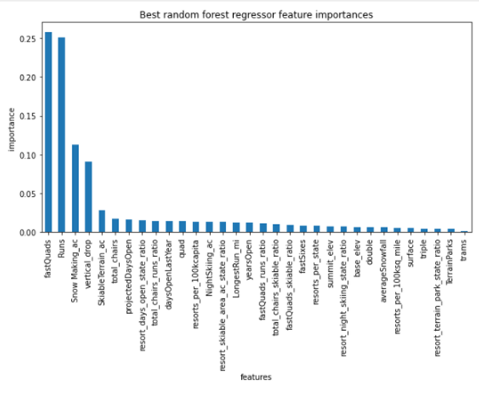
Fitting and Predicting
Pipes were created for both linear regression and random regressor, where the latter is performed better.
Cross validation was highly variable, best_params was applied and gave only 8 features.
Random regressor parameters were reset, and iterated again, the final MAE was obtained as 10.1.

Slide 7
Pricing
Two possibilities exist:
Predicting a price increase/decrease
Cost saving by reducing the features.
The best model was applied, and it observed that Big Mountain Resort modelled price is 93.77 USD, where actual price is 81.00 USD.
5 USD increase may result in a total of 7.5M USD (350K guests per 5 days stay in average) per year.

Slide 8
Cost-cutting and Investment
As far as cost saving is concerned, adding a run, increasing the vertical drop by 150 feet, and installing an additional chair lift; 1.99 USD increase that may sum 3.5M USD per year
Adding 2 acres of snow making on top of this does not appear to have incremental effect
Close up to 10 of the least used runs means Very slight price decrease with up to 6 (excluding) close ups, which makes it very much applicable

Slide 9
Future Directions
There is lack of information provided around the costs: Closing runs may have other benefits like decreasing the costs, other than the ticket price which is the primary target.
Moreover, when the length of the run is increased, we're having some gain with the pricing, however this is not a net value, since we don't know the size of the investment we need for the extra chairs.

